Slide 1

The Art Of Iterating
Update-Strategies in ABS
Jonathan Thaler
University of Nottingham

Slide 2
Agenda
Motivating Examples
Heroes & Cowards
Prisoner's Dilemma 2D
The Agent Metaphor
How can an Agent be awakened in a computational environment?
Update-Strategies
Four ways of awakening Agents
Conclusions

Slide 3
Motivating Examples

Slide 4
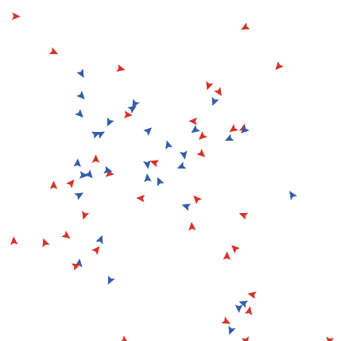
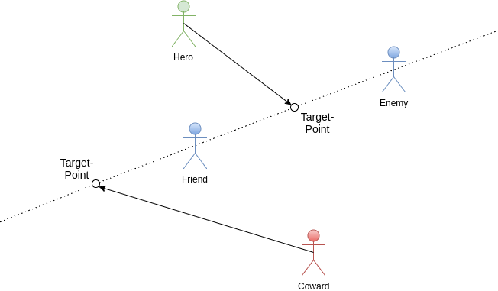
Heroes & Cowards (Wilensky & Rand, 2015)

Slide 5
Prisoner’s Dilemma 2D (Nowak & May, 1992)
Play Prisoner's Dilemma over multiple steps on 2D grid
Two prisoners cooperate (say nothing) or defect (betray each other)
4 outcomes & rewards: T > R > P > S
R: both cooperate
P: both defect
T / S: one defects (T) other one cooperates (S)
Notes:
4 possible outcomes
both cooperate
both defect
Either one cooperates other one defects
Dilemma: safest strategy for individual is defect but better reward if both cooperate

Slide 6

Prisoner’s Dilemma 2D cont’d
99x99 Grid single defector at center (50/50)
Play game with neighbours & self, sum reward
Compare payoffs, adopt role of best reward
Blue: Cooperators now & before Red: Defectors now & before Yellow: Cooperate now, defected before Green: Defect now, cooperated before
Notes:
Payoffs (T > R > P > S): S=P=0, R=1, T > b > 1

Slide 7
The Agent Metaphor
Notes:
Both examples are very different kind of “games” / simulations: how can we simulate them? Do we have to

Slide 8
Agent
Unique entity with internal state
Agent-Environment interaction
Agent-Agent interaction
Pro-Active
How can we raise Agents to existence in a computational environment?
Notes:
Internal state: full control
Pro-Activity: can initiate actions on its own
Ultimately the agent it is a metaphor

Slide 9
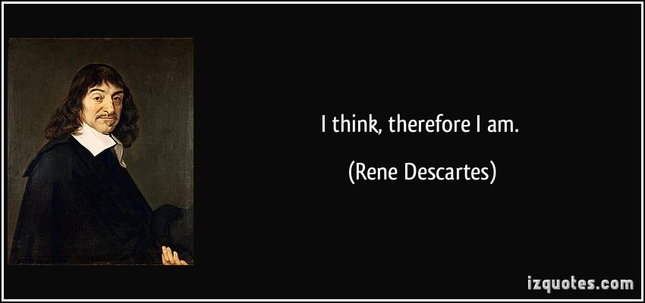

Slide 10
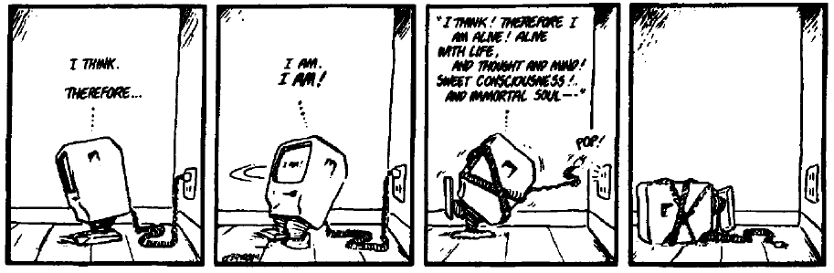

Slide 11
Pro-Activity
Need independent stimulus
Independent stimulus allows to perceive change
Time = Change = Time
Time in a computational environment: being executed / updated
Time a variable: increasing between updates
Notes:
Stimulus independent of the agent itself
Discrete: time increases in discrete steps (1, 2, 3, 4, … or 2, 7, 9, 15)
Continuous: time increases continuously (1.0, 1.1, 1.2, 1.3,...)
Real-Time: time increases with a system-clock e.g. milliseconds (1000, 2000, 3000), the simulation becomes then also a real-time simulation!
Ultimately: time = execution

Slide 12
Agent Updating
How execute a set of agents?
When is message M Agent A to Agent B visible to Agent B?
When is message M processed by Agent B?

Slide 13
Update-Strategies
Notes:
People have looked at this (see my paper) but so far inconsistent and incomplete terminology: synchronous vs. asynchronous
What is established is that one needs to be careful how agents are updated: the model-semantics need to be reflected in the update-semantics
What is missing: details, and options - there is more than synchronous and asynchronous

Slide 14
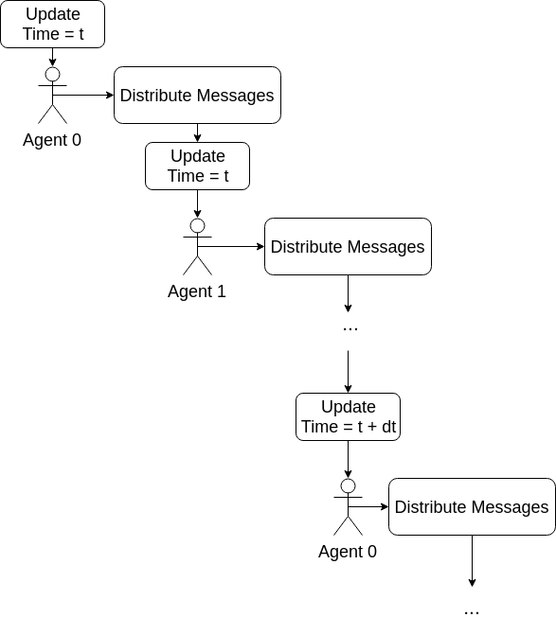
I: Sequential
Agents act after another
Global, absolute Time
Agents see changes of Agents before
Single, shared Thread
Deterministic
Imperative / OO languages (Java, C++) strong

Slide 15
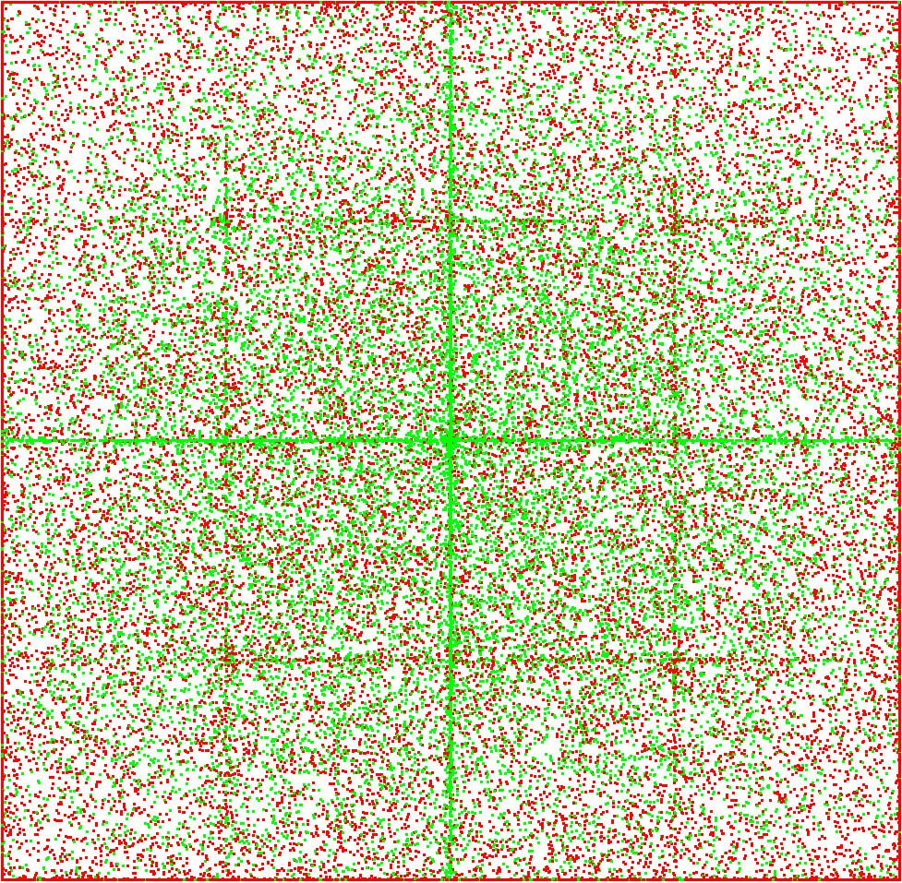
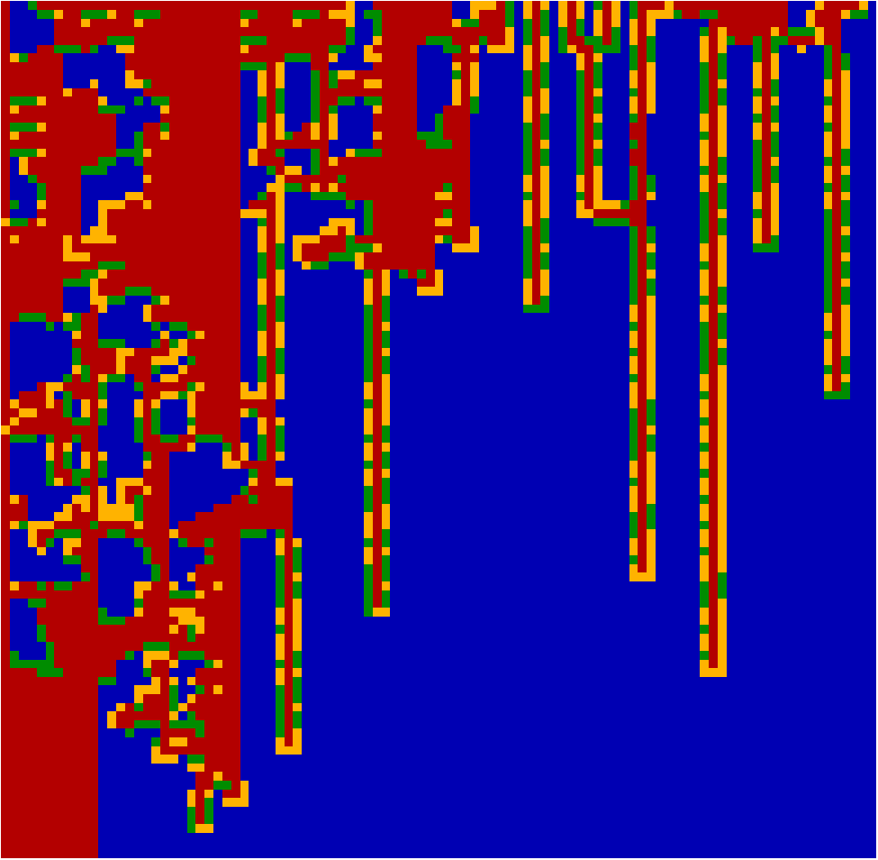
I: Sequential
Notes:
deterministic

Slide 16
I: Sequential
Notes:
deterministic

Slide 17
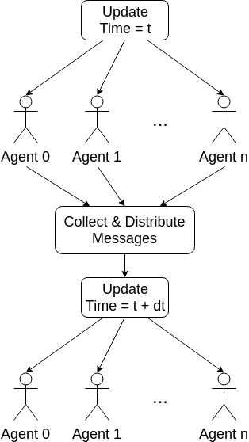
II: Parallel
Agents act at the same time in lockstep
Global, absolute Time
Actions not visible during update-step
Single shared / separate Threads
Deterministic
Functional languages (Haskell, Clojure) strong

Slide 18
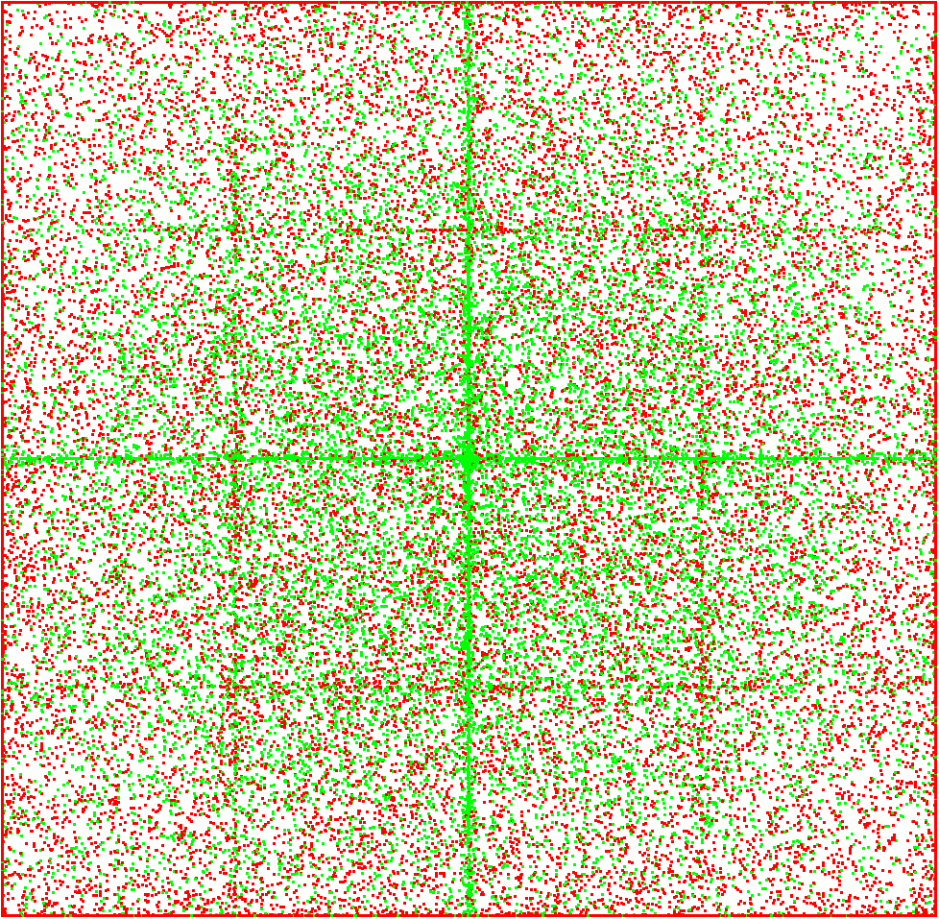

II: Parallel
Notes:
deterministic

Slide 19
II: Parallel
Notes:
deterministic

Slide 20
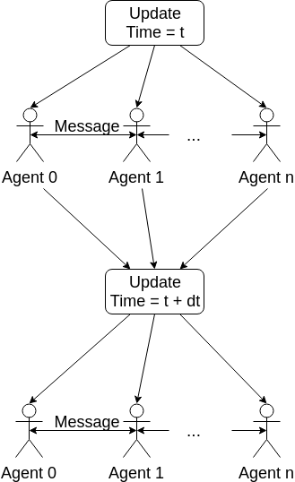
III: Concurrent
Agents act concurrently at the same time in lockstep
Global, absolute Time
Changes visible within update-step
Separate Threads
Non-Deterministic
Languages with concurrency features (Java, Haskell) strong
Notes:
Could allow direct method calls, but then a single agent could have multiple threads of execution at the same time

Slide 21
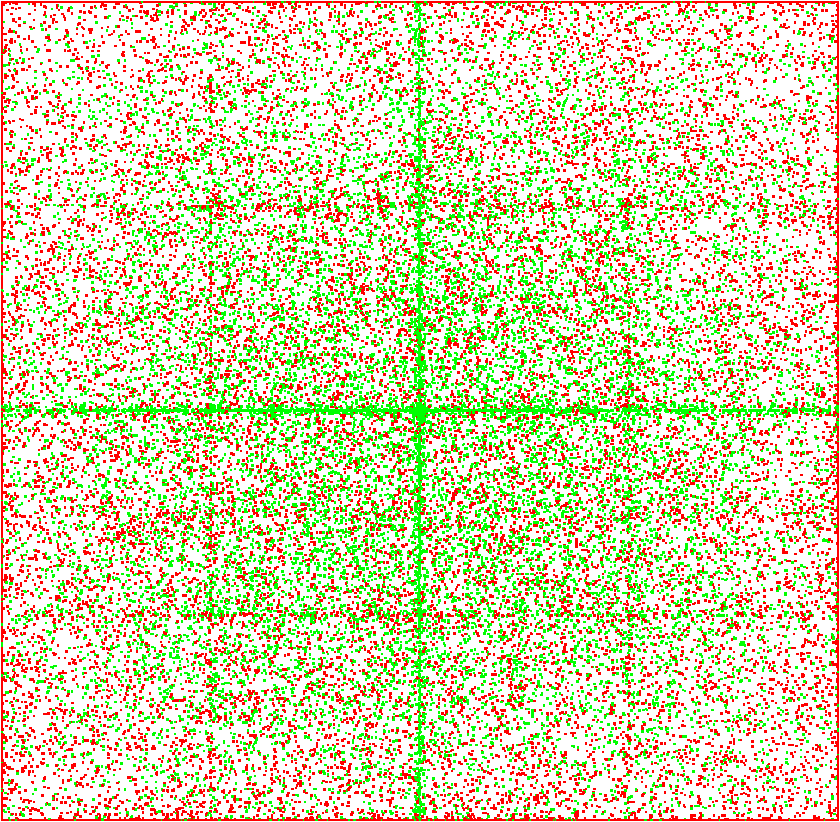
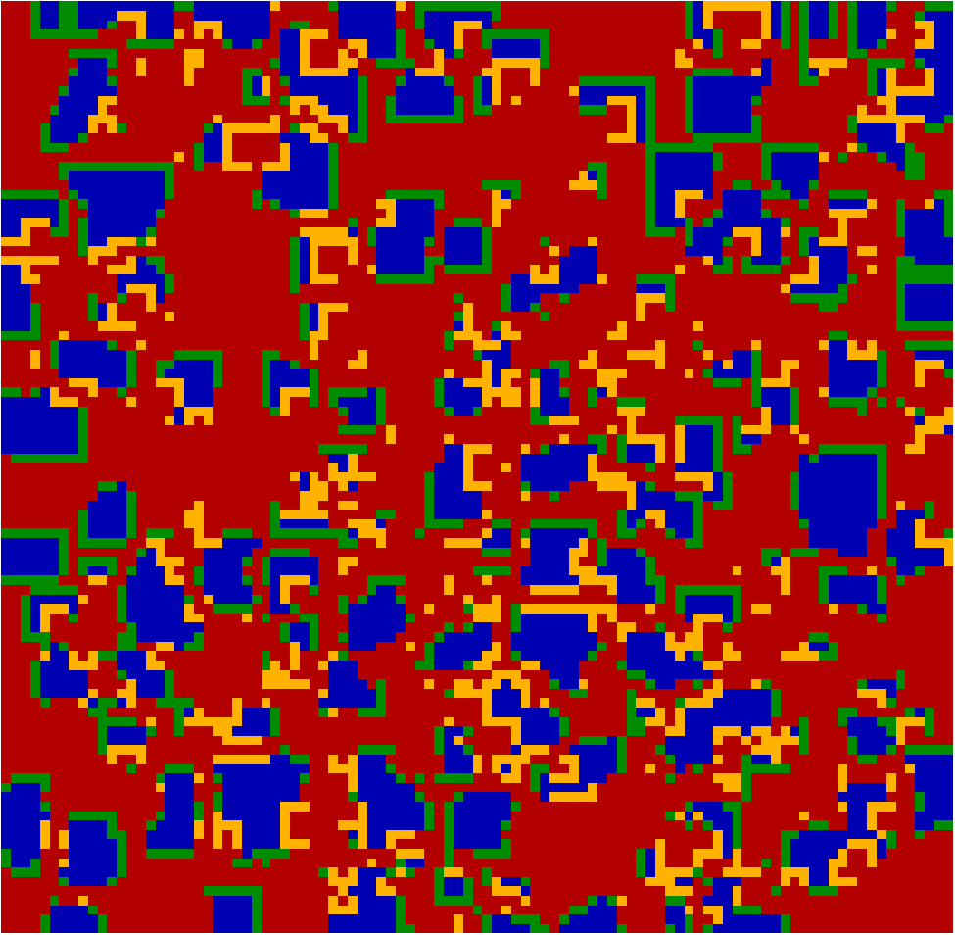
III: Concurrent
Notes:
deterministic

Slide 22
III: Concurrent
Notes:
deterministic

Slide 23
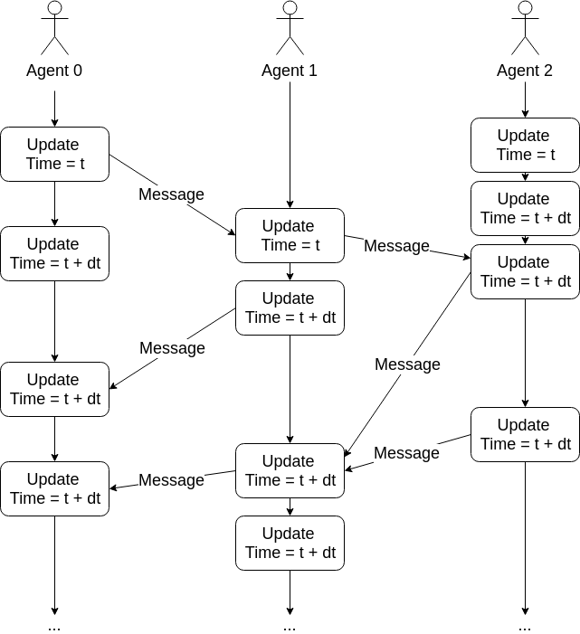
IV: Actor
Agents act at the same time in their own relative universe
Local time
Separate Threads
Non-Deterministic
Actor-based languages (Erlang, Scala) strong

Slide 24
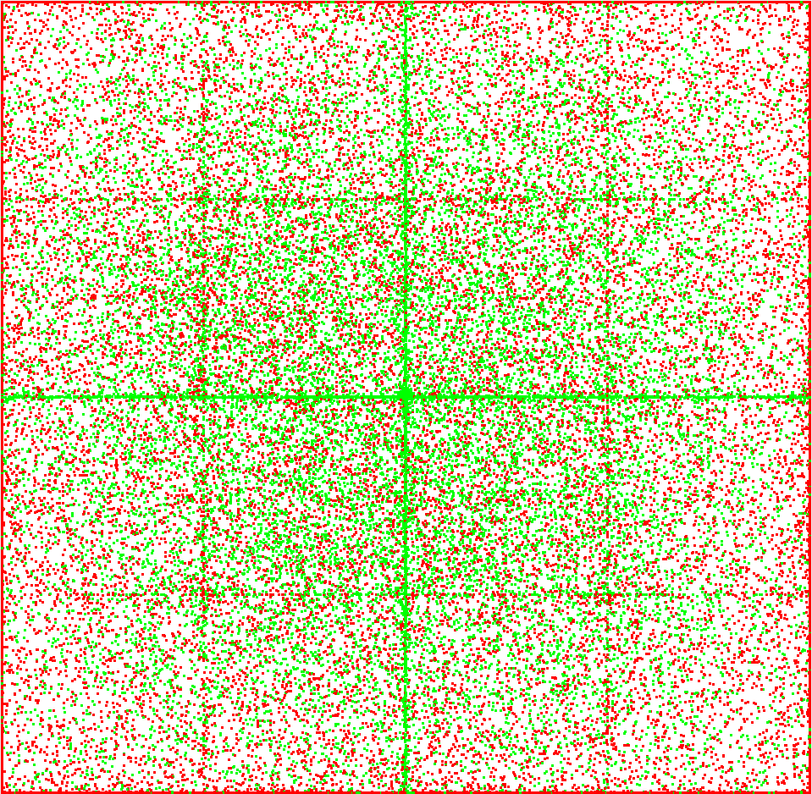
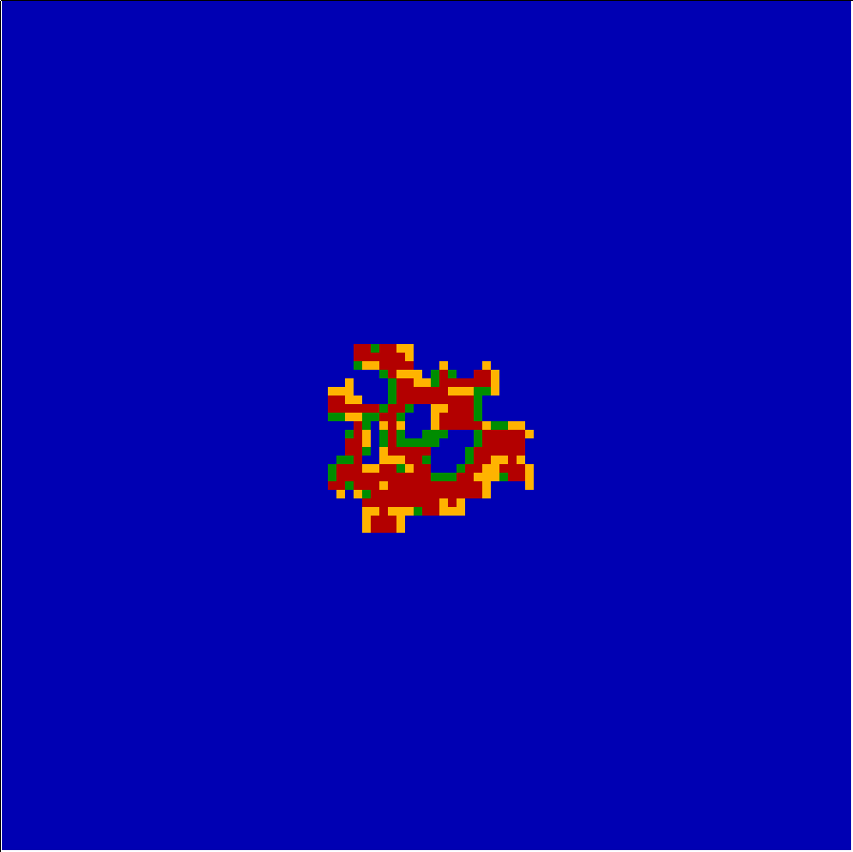
IV: Actor
Notes:
deterministic

Slide 25
IV: Actor
Notes:
deterministic

Slide 26
Conclusions
Pro-activity requires independent stimulus
Independent stimulus: Change = Time = being executed / updated
Match update-strategy to semantics of the model
Programming paradigms make a difference
Notes:
Because update-strategy must match model AND programming paradigms are suited differently to implement update-strategies
=> therefore select the right programming paradigm for implementing your model

Slide 27
Q & A

